Slide 1





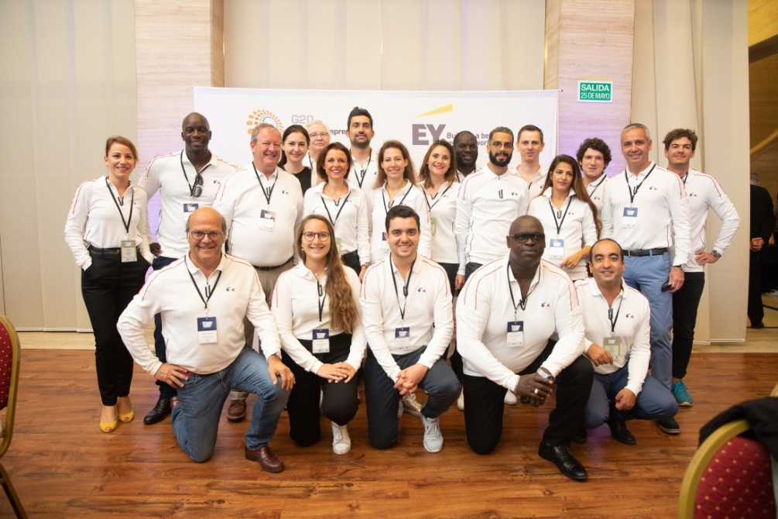
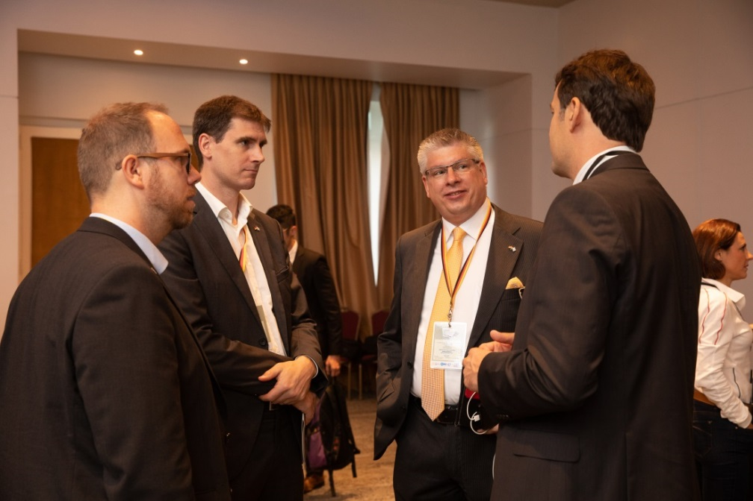


Slide 2





STARTUP
PROGRAMS
ACCELERATION
PROGRAMS
MENTORING
PROGRAMS
SCALEUP
PROGRAMS
EDUCATIONAL
PROGRAMS
ECOSYSTEM
PROGRAMS

Slide 4

ACCELERATION
PROGRAMS
SCALEUP
PROGRAMS
MENTORING
PROGRAMS

Slide 5
ACCELERATION
PROGRAMS
SCALEUP
PROGRAMS
MENTORING
PROGRAMS

Slide 6
STARTUP
PROGRAMS
ACCELERATION
PROGRAMS
MENTORING
PROGRAMS
SCALEUP
PROGRAMS
EDUCATIONAL
PROGRAMS
ECOSYSTEM
PROGRAMS

Slide 7
STARTUP
PROGRAMS
ACCELERATION
PROGRAMS
MENTORING
PROGRAMS
SCALEUP
PROGRAMS
EDUCATIONAL
PROGRAMS
ECOSYSTEM
PROGRAMS

Slide 8




